Slide 1
Module-2
Finite Automata

Slide 2
Language Recognizers : An example of Finite Automata
An automaton is an abstract model of a digital computer.
Finite Automata(FA) is the simplest machine to recognize patterns.

Slide 3
Finite Automaton
Input
String
Output
“Accept”
or
“Reject”
Finite
Automaton

Slide 4
Representation of Finite Automata
Finite Automata is represented by –
Transition Graph
Transition Table
Regular Expression

Slide 5
Transition Graph
initial
state
accepting
state
state
transition

Slide 6
Initial Configuration
Input String

Slide 7
Reading the Input

Slide 11
Input finished
accept

Slide 12
Rejection

Slide 16
Input finished
reject

Slide 17
Another Rejection

Slide 18
reject

Slide 19
Another Example

Slide 23
Input finished
accept

Slide 24
Rejection Example

Slide 28
Input finished
reject

Slide 29
Languages Accepted by FAs
Definition:
The language contains
all input strings accepted by
= { strings that bring
to an accepting state}

Slide 30
Example
accept

Slide 31
Example
accept
accept
accept

Slide 32
Example
trap state/
dead state
accept

Slide 33
Formal Definition
Finite Automaton (FA)
: set of states
: input alphabet
: transition function
: initial state
: set of accepting states
Dr. Gauri Kalnoor

Slide 34
Input Alphabet
Dr. Gauri Kalnoor

Slide 35
Set of States
Dr. Gauri Kalnoor

Slide 36
Initial State
Dr. Gauri Kalnoor

Slide 37
Set of Accepting States
Dr. Gauri Kalnoor

Slide 38
Transition Function
Dr. Gauri Kalnoor

Slide 39
Dr. Gauri Kalnoor

Slide 40
Dr. Gauri Kalnoor

Slide 41
Dr. Gauri Kalnoor

Slide 42
Transition Table
Dr. Gauri Kalnoor

Slide 43
Extended Transition Function
Dr. Gauri Kalnoor

Slide 44
Dr. Gauri Kalnoor

Slide 45
Dr. Gauri Kalnoor

Slide 46
Dr. Gauri Kalnoor

Slide 47
Observation: if there is a walk from to
with label then
Dr. Gauri Kalnoor

Slide 48
Example: There is a walk from to
with label
Dr. Gauri Kalnoor

Slide 49
Recursive Definition
Dr. Gauri Kalnoor

Slide 50
Dr. Gauri Kalnoor

Slide 51
Check the string acceptance of abba
δ*(qo,abba)= δ(δ*(q0,abb) , a)
= δ(δ (δ*(q0,ab),b) , a)
= δ(δ (δ (δ*(q0,a),b),b) , a)
= δ(δ (δ (δ (δ*(q0,λ),a),b),b) , a)
= δ(δ (δ (δ (q0,a),b),b) , a)
=δ(δ (δ (q1,b),b) , a)
=δ(δ (q2,b) , a)
=δ(q3, a)
=q4 Є F
String abba is accepted as q4 is a final state
Dr. Gauri Kalnoor

Slide 52
Language Accepted by FAs
For a FA
Language accepted by :
Dr. Gauri Kalnoor

Slide 53
Example
= { all strings with prefix }
accept
Dr. Gauri Kalnoor

Slide 54
L=strings with substring ‘101’ over {0, 1}
Dr. Gauri Kalnoor

Slide 55
Example
= { all strings without
substring }
Dr. Gauri Kalnoor

Slide 56
Example
Dr. Gauri Kalnoor

Slide 57
Regular Languages
Definition:
A language is regular if there is
FA such that
Observation:
All languages accepted by FAs
form the family of regular languages
Dr. Gauri Kalnoor

Slide 58
Examples of regular languages:
{ all strings with prefix }
{ all strings without substring }
There exist automata that accept these
Languages
Dr. Gauri Kalnoor

Slide 59
There exist languages which are not Regular:
Example:
There is no FA that accepts such a language
(we will prove this later in the class)
Dr. Gauri Kalnoor

Slide 60
Deterministic Finite Automata
Every State should have transition over every input symbol
There should be only One next state for each transition
DFA is defined as
Dr. Gauri Kalnoor

Slide 61
DFA Example
Design DFA that accepts language L= { w : |w| mod 3 = 0 }
over ∑ = {a, b}
Solution
Strings accepted= {ϵ, aaa, bbb, aba, aab, bab, aaabbb, ababab, …}
Strings rejected= {a, b, ab, ba, abab, baba, bbaa, aaabb, …}
Transition Diagram
Dr. Gauri Kalnoor

Slide 62
DFA Example
Consider Sample String : a a b
Dr. Gauri Kalnoor

Slide 63
DFA Example
Consider Sample String : a a b
Dr. Gauri Kalnoor

Slide 64
DFA Example
Consider Sample String : a a b
Dr. Gauri Kalnoor

Slide 65
DFA Example
Consider Sample String : a a b
String is accepted
Acceptance State
Dr. Gauri Kalnoor

Slide 66
DFA Example
Consider Another Sample String : b a b a
Dr. Gauri Kalnoor

Slide 67
DFA Example
Consider Another Sample String : b a b a
Dr. Gauri Kalnoor

Slide 68
DFA Example
Consider Another Sample String : b a b a
Dr. Gauri Kalnoor

Slide 69
DFA Example
Consider Another Sample String : b a b a
Dr. Gauri Kalnoor

Slide 70
DFA Example
Consider Another Sample String : b a b a
String is rejected
Rejection State
Dr. Gauri Kalnoor

Slide 71
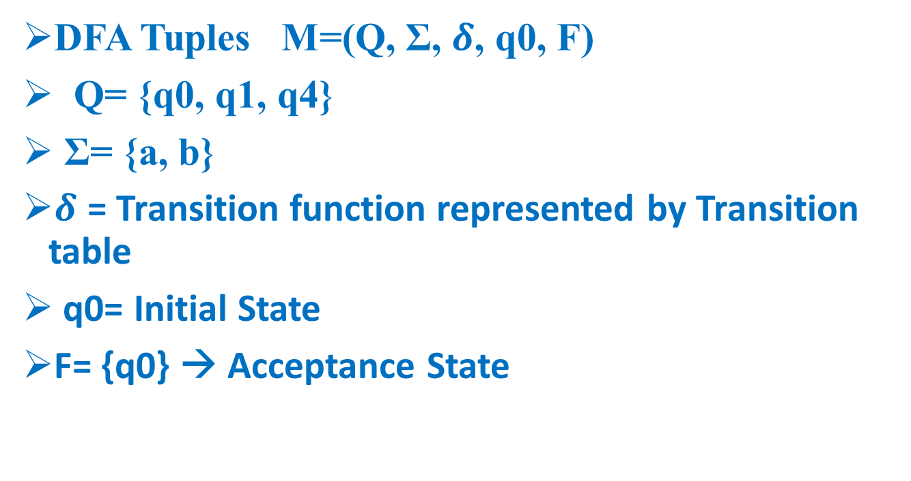
DFA Example
DFA Tuples M=(Q, Σ, $δ$, q0, F)
Q= {q0, q1, q4}
Σ= {a, b}
$δ$ = Transition function represented by Transition table
q0= Initial State
F= {q0} → Acceptance State
Dr. Gauri Kalnoor

Slide 72
DFA Example
Transition Table
Σ Q | a | b
*q0 | q1 | q1
q1 | q4 | q4
q4 | q0* | q0*
Dr. Gauri Kalnoor

Slide 73
DFA - Starts with a , ∑={a,b}
L= { a,aa,ab,aaa,aab,aba,….}
a,b
a
q0
q1
b
q2
a,b
Dr. Gauri Kalnoor

Slide 74
DFA - Starts with ab , ∑={a,b}
L= { ab,aba,abb,….}
a,b
a
b
q0
q1
q2
b
a
q3
a,b
Dr. Gauri Kalnoor

Slide 75
DFA - Starts with aa , ∑={a,b}
L = { aa,aab,aaba,….}
a,b
a
a
q1
q2
q0
b
b
q3
a,b
Dr. Gauri Kalnoor

Slide 76
DFA - Starts with aba , ∑={a,b}
L={ aba,abaa,abab,abaaa,…}
a,b
a
b
a
q0
q1
q2
q3
a
b
b
q4
a,b
Dr. Gauri Kalnoor

Slide 77
DFA - Starts with 101 , ∑={0,1}
L={ 101,1010,1011,101101,…}
0,1
1
0
1
q0
q1
q2
q3
1
0
0
q4
0,1
Dr. Gauri Kalnoor
77

Slide 78
Ends with a
L={a,aa,ba,aaa,aba,…}
b
a
a
q0
q1
b
Dr. Gauri Kalnoor

Slide 79

L={ 1,01,11,…}
0
1
1
q0
q1
0
Dr. Gauri Kalnoor

Slide 80
Ends with ab
L={ab,aab,bab,aaab,bbbbab,abab,…}
b
a
a
b
a
q2
q0
q1
a
b
Dr. Gauri Kalnoor

Slide 81
Ending with bab
b
a
b
b
a
b
q0
a
q3
q1
q2
a
a
Dr. Gauri Kalnoor
81

Slide 82
DFA – Ends with 101, ∑={ 0,1}
L={ 101,0101,1101,000101,111101,…}
1
0
1
0
0
1
1
q1
q2
q3
q0
0
Dr. Gauri Kalnoor

Slide 83
DFA – Ends with 111 , ∑={ 0,1}
L= { 111,0111,11111,…}
0
0
1
1
1
1
q1
q0
q2
q3
0
0
Dr. Gauri Kalnoor

Slide 84
DfA – Substring 101
L={ 101,0101,1101,1010,1011,00010111,…}
0
1
0,1
1
0
1
q1
q2
q3
q0
0
Dr. Gauri Kalnoor

Slide 85
DFA- Contains 111
L={ 111,0111,1111,000111000,11111000,..}
0
0,1
1
1
1
q0
q1
q2
q3
0
0
Dr. Gauri Kalnoor

Slide 86
DFA – Contains 1011
L= { 1011,01011,11011,00010111,..}
0
1
0,1
1
0
1
1
q0
0
0
Dr. Gauri Kalnoor

Slide 87
DFA- Even no of 0s, ∑={ 0,1} or n0(w)mod2=0
L={ λ, 1,1111,00,0000,11100,1110000,0000111,..}
1
1
0
q0
q1
Transition | o | 1
*->q0 | q1 | q0
q1 | qo | q1
0
Dr. Gauri Kalnoor

Slide 88
DFA – Odd no of 0’s , ∑={ 0,1} or n0(w)mod2=1
L={ 0,01,1110,000,000001111,…}
1
1
0
q1
q0
0
Dr. Gauri Kalnoor

Slide 89
DFA - na(w)mod3=0, ∑={ a,b}
L={ λ,bbbb,aaabbb,aaaaaabbb,….}
b
b
b
a
a
a
Dr. Gauri Kalnoor

Slide 90
DFA- nb(w)mod4=1, ∑={ a,b}
a
a
a
a
b
b
b
b
Dr. Gauri Kalnoor

Slide 91
DfA – n1(w)mod3=2, ∑={ 0,1}
0
0
0
1
1
1
Dr. Gauri Kalnoor

Slide 92
Dfa –lwlmod2=0,
a,b
a,b
Dr. Gauri Kalnoor

Slide 93
DfA – lwlmod2=1
L={a,b,aaa,aba,aab,baa,bbb,baba,bba,….
a,b
a,b
Dr. Gauri Kalnoor

Slide 94
DFA –lwlmod3=0, ∑={ 0,1}
a,b
a,b
a,b
Dr. Gauri Kalnoor

Slide 95
No of a’s is even and no of b’s odd-eo
a
oe
ee
a
b
b
b
b
a
eo
oo
a
Dr. Gauri Kalnoor

Slide 96
No of a’s is odd and no of b’s even=oe
a
oe
ee
a
b
b
b
b
a
eo
oo
a
Dr. Gauri Kalnoor

Slide 97
No of a’s is odd and no of b’s odd-oo
a
oe
ee
a
b
b
b
b
a
eo
oo
a
Dr. Gauri Kalnoor

Slide 98
No of a’s is even and no of b’s even-ee
a
ee
oe
a
b
b
b
b
a
eo
oo
a
Dr. Gauri Kalnoor

Slide 99
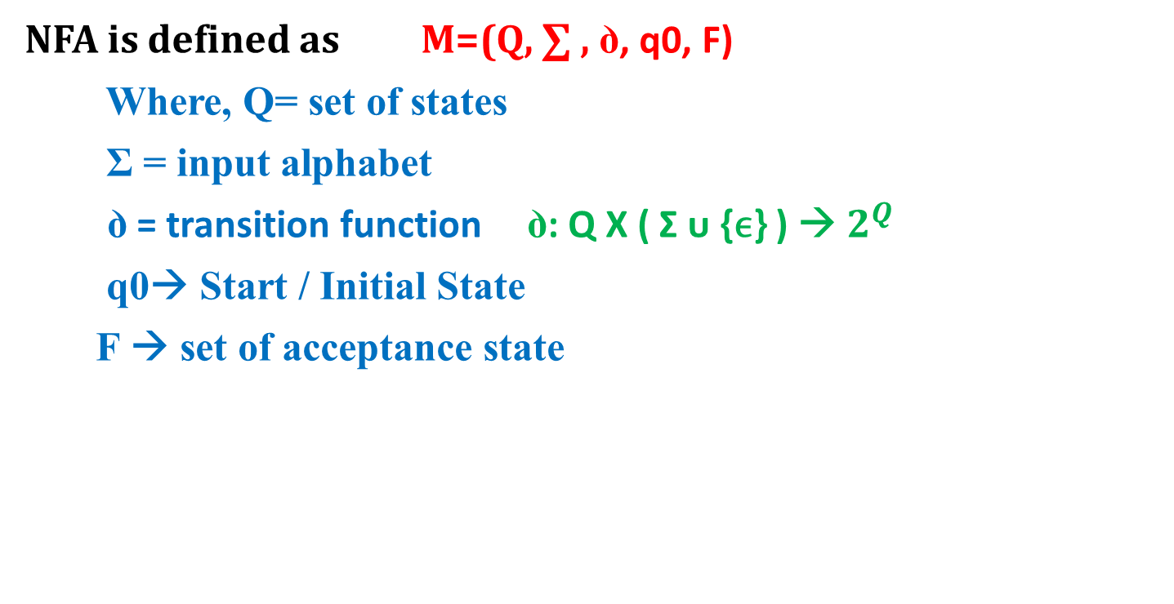
NFA Definition
NFA is defined as M=(Q, ∑ , ꝺ, q0, F)
Where, Q= set of states
Σ = input alphabet
ꝺ = transition function ꝺ: Q X ( Σ ᴜ {ϵ} ) → $2^{Q}$
q0→ Start / Initial State
F → set of acceptance state
Dr. Gauri Kalnoor

Slide 100
NFA Example
Design NFA that accepts language of strings ending with ab/ba over ∑ = {a, b}
Solution
Strings accepted= {ab, ba, abab, baba, bbab, aaaba, …}
Strings rejected= {ϵ, a, b, aa, bb, aaa, abb, aaabbb, …}
Transition Diagram
Dr. Gauri Kalnoor

Slide 101
NFA to DFA Conversion Example
Convert NFA to DFA that accepts language of strings ending with ab/ba over ∑ = {a, b}
Solution
Draw NFA for given language
Convert that NFA into DFA using subset construction method
Dr. Gauri Kalnoor

Slide 102
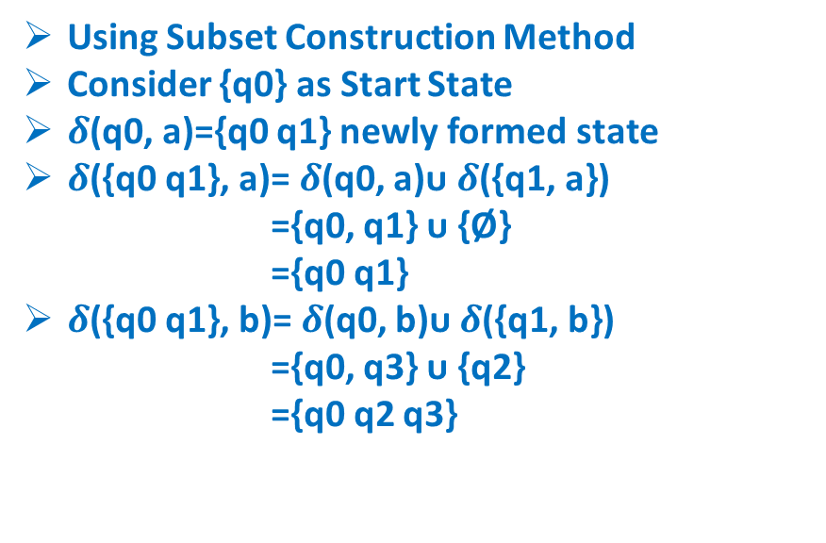
NFA to DFA Conversion Example
Using Subset Construction Method
Consider {q0} as Start State
$δ$(q0, a)={q0 q1} newly formed state
$δ$({q0 q1}, a)= $δ$(q0, a)ᴜ $δ$({q1, a})
={q0, q1} ᴜ {Ø}
={q0 q1}
$δ$({q0 q1}, b)= $δ$(q0, b)ᴜ $δ$({q1, b})
={q0, q3} ᴜ {q2}
={q0 q2 q3}
NFA | a | b
q0 | {q0, q1} | {q0, q3}
q1 | - | {q2}
q2 | - | -
q3 | {q4} | -
q4 | - | -
DFA | a | b
q0 | {q0 q1} | {q0 q3}
{q0 q1} | {q0 q1} | {q0 q2 q3}
Dr. Gauri Kalnoor

Slide 103
NFA to DFA Conversion Example
Using Subset Construction Method
Consider {q0} as Start State
𝜹(q0, a)={q0 q1} newly formed state
𝜹({q0 q1}, a)= 𝜹(q0, a)ᴜ 𝜹({q1, a})
={q0, q1} ᴜ {Ø}
={q0 q1}
𝜹({q0 q1}, b)= 𝜹(q0, b)ᴜ 𝜹({q1, b})
={q0, q3} ᴜ {q2}
={q0 q2 q3}
{q0 q2 q3} is newly formed state
𝜹({q0 q2 q3}, a)= 𝜹(q0, a) ᴜ 𝜹({q2, a}) ᴜ 𝜹({q3, a})
={q0, q1} ᴜ {Ø} ᴜ {q4}
={q0 q1 q4}
𝜹({q0 q2 q3}, b)= 𝜹(q0, b)ᴜ 𝜹({q2, b}) ᴜ 𝜹({q3, b})
={q0, q3} ᴜ {Ø} ᴜ {Ø} ={q0 q3}
NFA | a | b
q0 | {q0, q1} | {q0, q3}
q1 | - | {q2}
q2 | - | -
q3 | {q4} | -
q4 | - | -
DFA | a | b
q0 | {q0 q1} | {q0 q3}
{q0 q1} | {q0 q1} | {q0 q2 q3}
{q0 q2 q3) | {q0 q1 q4} | {q0 q3}
Dr. Gauri Kalnoor

Slide 104
NFA to DFA Conversion Example
{q0 q3} is newly formed state
𝜹({q0 q3}, a)= 𝜹(q0, a)ᴜ 𝜹({q3, a})
={q0, q1} ᴜ {q4}
={q0 q1 q4}
𝜹({q0 q3}, b)= 𝜹(q0, b)ᴜ 𝜹({q3, b})
={q0, q3} ᴜ {Ø}
={q0 q3}
NFA | a | b
q0 | {q0, q1} | {q0, q3}
q1 | - | {q2}
q2 | - | -
q3 | {q4} | -
q4 | - | -
DFA | a | b
q0 | {q0 q1} | {q0 q3}
{q0 q1} | {q0 q1} | {q0 q2 q3}
{q0 q2 q3) | {q0 q1 q4} | {q0 q3}
{q0 q3} | {q0 q1 q4} | {q0 q3}
Dr. Gauri Kalnoor

Slide 105
NFA to DFA Conversion Example
{q0 q3} is newly formed state
𝜹({q0 q3}, a)= 𝜹(q0, a)ᴜ 𝜹({q3, a})
={q0, q1} ᴜ {q4}
={q0 q1 q4}
𝜹({q0 q3}, b)= 𝜹(q0, b)ᴜ 𝜹({q3, b})
={q0, q3} ᴜ {Ø}
={q0 q3}
{q0 q1 q4} is newly formed state
𝜹({q0 q1 q4}, a)= 𝜹(q0, a) ᴜ 𝜹({q1, a}) ᴜ 𝜹({q4, a})
={q0, q1} ᴜ {Ø} ᴜ {Ø}
={q0 q1}
𝜹({q0 q1 q4}, b)= 𝜹(q0, b)ᴜ 𝜹({q1, b}) ᴜ 𝜹({q4, b})
={q0, q3} ᴜ {q2} ᴜ {Ø}
={q0 q2 q3}
NFA | a | b
q0 | {q0, q1} | {q0, q3}
q1 | - | {q2}
q2 | - | -
q3 | {q4} | -
q4 | - | -
DFA | a | b
q0 | {q0 q1} | {q0 q3}
{q0 q1} | {q0 q1} | {q0 q2 q3}
{q0 q2 q3) | {q0 q1 q4} | {q0 q3}
{q0 q3} | {q0 q1 q4} | {q0 q3}
{q0 q1 q4} | {q0 q1} | {q0 q2 q3}
Dr. Gauri Kalnoor

Slide 106
NFA to DFA Conversion Example
DFA | a | b
q0 | {q0 q1} | {q0 q3}
{q0 q1} | {q0 q1} | {q0 q2 q3}
{q0 q2 q3) | {q0 q1 q4} | {q0 q3}
{q0 q3} | {q0 q1 q4} | {q0 q3}
{q0 q1 q4} | {q0 q1} | {q0 q2 q3}
Dr. Gauri Kalnoor

Slide 107
Minimization of DFA Example
Minimize the following DFA using state equivalence method
DFA | 0 | 1
A | B | C
B | B | D
C | B | C
D | B | E
E* | B | C
Dr. Gauri Kalnoor

Slide 108
Minimization of DFA Example
Minimize the following DFA
Use State Equivalence Method
Write 0’Equivalence as
{A, B, C, D} {E}
Write 1’Equivalence
{A, B, C} {D} {E}
Write 2’Equivalence
{A, C} {B} {D} {E}
Write 3’Equivalence
{A, C} {B} {D} {E}
DFA | 0 | 1
A | B | C
B | B | D
C | B | C
D | B | E
E* | B | C
Dr. Gauri Kalnoor

Slide 109
Minimization of DFA Example
Minimize the following DFA
Use State Equivalence Method
Write 0’Equivalence as
{A, B, C, D} {E}
Write 1’Equivalence
{A, B, C} {D} {E}
Write 2’Equivalence
{A, C} {B} {D} {E}
Write 3’Equivalence
{A, C} {B} {D} {E}
DFA | 0 | 1
A,C | B | C
B | B | D
D | B | E
E* | B | C
Dr. Gauri Kalnoor

Slide 110
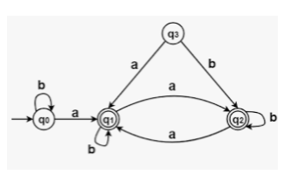

Slide 111
Ɛ-NFA (Finite Automaton with Epsilon Transitions)
A transition with an empty string is called an Ɛ-transition
The formal definition of ∈-NFA is represented through 5-tuple (Q, ∑, δ, q₀, F) where,
Q is a finite set of all states (q_{0,} q_{1,} q_{2, …} q_{n}) where n is finite number
∑ is a finite set of symbols called the alphabet. i.e. {0, 1},
δ : Q x (∑ U ∈) → 2^{Q} is a total function called as transition function
q₀ is the initial state from where any input is processed (q₀ ∈ Q).
F is a set of final state/states where F will be subset ( ⊆ ) of Q.

Slide 112
Examples of Epsilon-NFA
Draw a Epsilon NFA which accept the string “ab”.
q0
a
q1
b
q2
NFA
q0
a
q1
ϵ
q2
b
q3
ϵ-NFA

Slide 113
Example 2
Draw an Epsilon Finite Automata which can accept the string “a or b or c”

Slide 114
Conversion of ϵ-NFA to DFA
The method for converting the NFA with ε to DFA is explained below −
Step 1 − Consider M={Q, Σ, δ,q0,F) is NFA with ε. We have to convert this NFA with ε to equivalent DFA denoted by
M0=(Q0,Σ, δ0,q0,F0)
Then obtain,
ε-closure(q0) ={p1,p2,p3,……pn}
then [p1,p2,p2,….pn] becomes a start state of DFA
now[p1,p2,p3,….pn] ∈ Q0

Slide 115
Step 2 − We will obtain δ transition on [p1,p2,p3,…pn] for each input.
δ 0([p1,p2,p3,..pn],a) = ε-closure(δ(p1,a) U δ(p2,a)U……………… δ(pn,a))= U (i=1 to n) ε-closure d(pi,a)
Where a is input ∈Σ
Step 3 − The state obtained [p1,p2,p3,…pn] ∈ Q0 .
The states containing final state in pi is a final state in DFA.

Slide 116
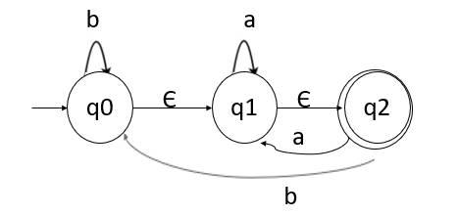
Example of Conversion
Convert the following NFA with epsilon to equivalent DFA

Slide 117
To convert this NFA with epsilon, we will first find the ε-closures, as given below −
ε-closure(q0)={q0,q1,q2}
ε-closure(q1)={q1,q2}
ε-closure(q2)={q2}
Let us start from ε-closure of start state, as mentioned below −
When, ε-closure(q0)={q0,q1,q2}, we will call this state as A.
Now, let us find transition on A with every input symbol, as shown below −

Slide 118
δ'(A, a) = ε-closure(δ(A,a))
= ε-closure(δ(q0,q1,q2), a))
= ε-closure(δ(q0, a) ∪ δ(q1,a) U δ(q2,a) )
= ε-closure(Φ ∪ q1 ∪q1)
= ε-closure(q1)
= {q1, q2} let us call it as state B

Slide 119
δ'(A, b) = ε-closure(δ(A,b))
= ε-closure(δ(q0,q1,q2), b))
= ε-closure(δ(q0, b) ∪ δ(q1,b) U δ(q2,b) )
= ε-closure(q0 U Φ∪q0)
= ε-closure(q0)
= {q0,q1, q2} its nothing but state A

Slide 120
δ'(B, a) = ε-closure(δ(B,a))
= ε-closure(δ(q1,q2), a))
= ε-closure(δ(q1,a) U δ(q2,a) )
= ε-closure(q1 ∪q1)
= ε-closure(q1)
= {q1, q2} its nothing but state B

Slide 121
δ'(B, b) = ε-closure(δ(B,b))
= ε-closure(δ(q1,q2), b))
= ε-closure(δ(q1,b) U δ(q2,b) )
= ε-closure(Φ∪q0)
= ε-closure(q0)
= {q0,q1, q2} its nothing but state A

Slide 122
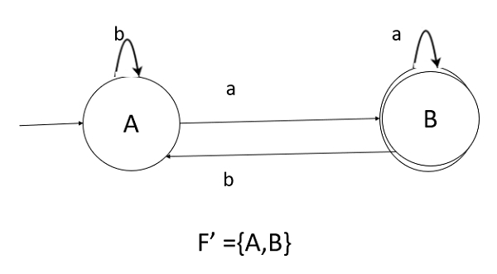
Hence, the transition table for the generated DFA is as follows −
States\inputs | a | b
A | B | A
B | B | A

Slide 123
As, A={q0,q1,q2} in which the final state q2 lies. Hence, A is the final state.
In B ={q1,q2} the state q2 lies. Hence, B is also the final state.

Slide 124
END of MODULE 2

Slide 125
Exercises

